Slide 1
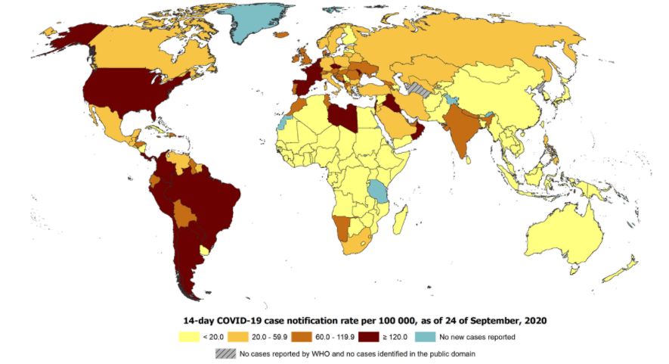
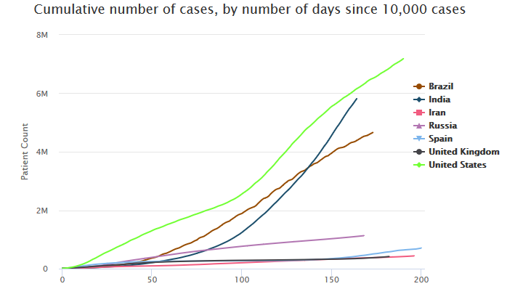
Short Update 38a COVID-19 Coronavirus Disease 25th of September 2020
GLOBAL 32 126 562 Confirmed cases 22 168 450 recovered 981 986 deaths | News: There have been some reports about researchers testing vaccines they’ve developed on themselves. Such self-experiments raise numerous ethical and legal questions and have to be regulated quickly, researchers from the US and Denmark demanded in the Science Magazine. They claim that if there is no regulation on self-experiments, the public’s trust in the development of safe corona vaccines could be compromised. Several scientists from the US released statements in which they described their self-experiments with various vaccine candidates. Similar statements were reported from Russia, China and other countries. According to the World Health Organization, currently there are almost 200 projects worldwide looking for suitable vaccines to protect against corona. Experts do not expect suitable vaccines to be widely available until the coming year. WHO and UN: specialised agencies and partners today called on countries to develop and implement action plans to promote the timely dissemination of science-based information and prevent the spread of false information while respecting freedom of expression. WHO published an .interim guidance on seasonal influenza vaccination recommendations during the COVID-19 pandemic. WHO’s health emergencies online learning platform: OpenWHO.org. Find Articles and other materials about COVID-19 on our website here. Please use our online observation form to report your lessons learned observations as soon as possible here. Topics: Global situation Subject in Focus: Small group of rich nations has bought up more than half the future supply of leading COVID-19 vaccine contenders In the press |  | EUROPE 4 987 425 confirmed cases 2 617 000 recovered 226 851 deaths
 |  |  | Russia (new cases/day 6 489) ↗ 1 123 976 confirmed cases 926 663 recovered 19 867 deaths
USA (new cases/day 32 007) ↘ 6 929 905 confirmed cases 2 707 378 recovered 202 109 deaths
 |  |  | SPAIN (new cases/day 10 653) ↗ 704 209 confirmed cases 150 376 recovered 31 118 deaths
Brazil (new cases/day 33 521) ↘ 4 657 702 confirmed cases 4 102 954 recovered 139 808 deaths
 |  |  | GBR (new cases/day 6 634) ↗ 416 363 confirmed cases not reported recovered 41 902 deaths
India (new cases/day 86 508) ↘ 5 732 518 confirmed cases 4 674 987 recovered 91 149 deaths
Disclaimer:
This update provided by the NATO Centre of Excellence (NATO MILMED COE) on its website is for general information purposes only and cannot be considered as official recommendation. All national and international laws, regulations, and guidelines as well as military orders supersede this information.
All information is provided in good faith, however, the NATO MILMED COE makes no representation or warranty of any kind, express or implied, regarding the accuracy, adequacy, validity, reliability, availability or completeness of any information.
The information published on this website is not intended to substitute professional medical advice, diagnosis or treatment.
The NATO MILMED COE disclaim any liability in connection with the use of this information.

Slide 2
Global Situation
DEU: The “7-day incidence” (cumulative number of new cases per 100,000 within 7 days) is an important indicator for the German government to determine which areas are considered as “risk areas”. If the 7-day incidence exceeds 50 in a city or in a district, the mandatory additional protective measures are required.
The federal government has lately declared various regions as corona risk areas due to the increasing number of infections. This also includes the Danish capital Copenhagen, the Dublin region in Ireland, the Utrecht province in the Netherlands and the Lisbon region in Portugal. Some German cities (e.g. Munich) also exceeded the limit of 50.
-----------------------------------------------------------------------------------------------------------------------------------------------------------
FRA: France is closing bars and restaurants in some parts of the country in the fight against the coronavirus. For the southern French port metropolis of Marseille and the overseas region of Guadeloupe, the “maximum alert” has been declared. All bars and restaurants there would have to remain closed from Saturday onwards. In the capital Paris and other large cities such as Lille or Rennes, bars would have to close at 10 p.m. starting on Monday. Due to the "high alert“ there is a limit for meetings in public, allowing only a maximum of ten people. In the severely affected city of Marseille, all publicly accessible facilities also have to be closed unless they had introduced a “strict health protocol”. Theatres and cinemas are not affected. The objective is not to close the bars and restaurants in the port city for more than two weeks.
-----------------------------------------------------------------------------------------------------------------------------------------------------------
FIN: Sniffer dogs are said to detect the corona virus at Helsinki International Airport. Four dogs of different breeds started their work in the Finnish capital on Wednesday. Should the four-month test prove to be successful, infected travellers could be quickly identified in a cost-effective manner.
-----------------------------------------------------------------------------------------------------------------------------------------------------------
ISR: A few days after the start of a second nationwide lockdown, the corona numbers in Israel have risen to a record high. The Ministry of Health announced on Wednesday that 6,923 cases had been registered the day before. Reporting that many new infections within one day is unprecedented in the country - however, the number of tests has recently increased. Four months ago, on May 23, only 5 new infections were recorded. For comparison: around nine million people live in Israel. This is 1/9 of Germany population (in Germany 1,769 new infections were reported within the last 24 hours). A lockdown has been in effect in the Mediterranean country again since Friday. People have to come to terms with school closings and restrictions on the freedom of movement. The government wants to prevent the health system from being overwhelmed with the restrictions that are initially introduced for three weeks.
-----------------------------------------------------------------------------------------------------------------------------------------------------------
ESP: reported more than 10,000 new corona cases on Tuesday. But even more frightening: According to Worldometers, the number of deaths was 241, the highest it has been since May 6th. Last week there had been an increase between 150 and 240 new deaths , at the weekend the number has fallen to a little more than 50 per day. After a long phase of near stagnation, the number of cumulative deaths in Spain is clearly increasing again.
----------------------------------------------------------------------------------------------------------------------------------------------------------
IRN: reported the highest increase of COVID-19 cases since the outbreak of the pandemic. The Ministry of Health reported 3,712 new cases.
GBR: The number of infections is rising rapidly throughout Great Britain: In the past few days, 3,500 to 4,000 new cases have been reported almost daily, and the number of infections has doubled within seven days. If the virus continues to spread unhindered at the same pace, the UK could count nearly 50,000 cases per day by mid-October, leading health experts warn. The government is therefore also considering a temporary shutdown of public life, a kind of compulsory break of two to three weeks, during which restaurants and pubs could be completely closed again. Many parts of the country are already living with stricter measures. The British government is also recommending to resume to work from home in the fight against the corona virus.
-----------------------------------------------------------------------------------------------------------------------------------------------------------
USA: US retail group Walmart has launched a pilot program to deliver Covid-19 tests. Drones are said to deliver the tests directly to homes within a mile from the North Las Vegas store. Customers do not have to buy the tests in person in the store. The drones land on people's driveways, sidewalks or backyards, for example. Delivery, which only takes five minutes, is free. The samples can then be sent via FedEx to a laboratory, which provides information about the result in a digital way. The pilot program provides an insight into how drones could be used in the not too distant future to enable faster and contactless delivery.
-----------------------------------------------------------------------------------------------------------------------------------------------------------
MEX: According to a hospital, Mexico successfully performed a lung transplant on a Covid-19 patient. According to a statement, the 55-year-old had already underwent surgery for seven hours on August 31 at the Christ Muguerza private hospital in the city of Monterrey. According to the clinic, the operation was the first successful double lung transplant on a Covid-19 patient in Latin America. In May, the first lung transplant on a Covid patient in Europe was successful in Vienna. This kind of transplant has already happened in the USA before.
-----------------------------------------------------------------------------------------------------------------------------------------------------------
EU: In the light of the increasing corona numbers in Europe, the European Union is continuing to build up common reserves of medical protective masks. After Germany and Romania, Denmark, Greece, Hungary and Sweden have now also agreed to set up depots on behalf of all EU states, said EU Commissioner Janez Lenarcic on Tuesday. The construction of the joint reserve began in spring when many countries had far too little protective equipment for doctors and nurses in the Corona crisis. From this reserve 520,000 medical FFP2 and FFP3 masks have now been distributed to the EU states Italy, Spain, Croatia and Lithuania as well as to the neighbours North Macedonia, Montenegro and Serbia, said Lenarcic. The stocks are financed from the EU's budget. Individual EU states purchase the material and store it. In an emergency, it will be distributed as needed.
-----------------------------------------------------------------------------------------------------------------------------------------------------------

Slide 3
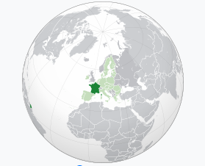
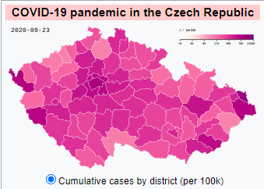
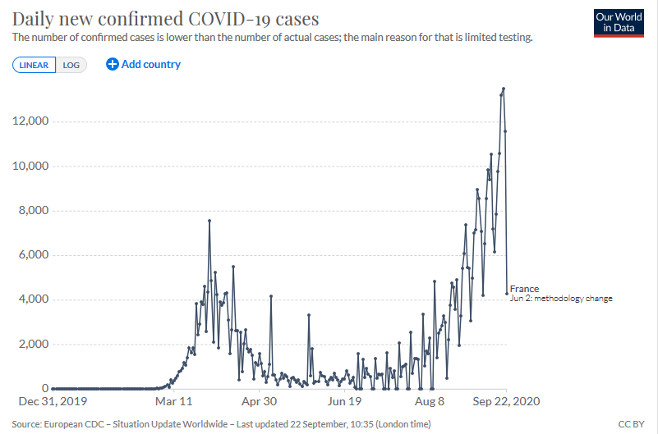
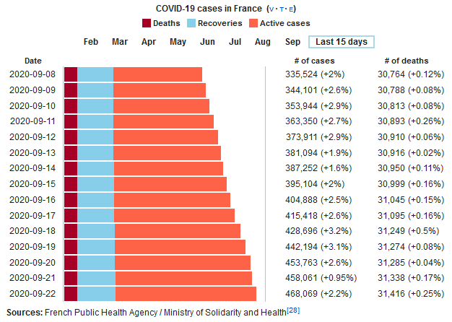
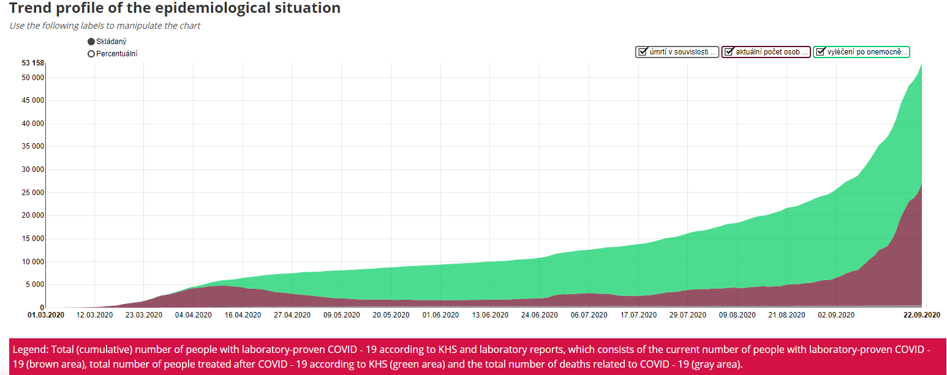
Global Situation
Czech Republic:
The Czech Republic is now severely affected by COVID-19. According to the EU health agency ECDC, the Czech Republic is now second behind Spain in terms of new infections per 100,000 inhabitants, with a 14-day average of 193. Currently there are almost 49,300 infected people and 503 deaths with a population of around 10.7 million.
France:
France is one of several European countries that are currently experiencing an increase in new cases. Since school started at the beginning of September, France has been concerned about the high number of new infections. Health Minister Olivier Véran warned that if the number of infections continued to develop exponentially, there would soon be more patients in the intensive care units. These concerns now materialized: The infection rates in France have increased in all age groups since June, but according to official data the increase is especially significant among young adults. A total of 81 schools have closed in France after students tested positive for the virus. Classes will be stopped as soon as there are 3 cases, said Education Minister Jean-Michel Blanquer. The current infection figures show that the dreaded second wave is now rolling across the country: France has recorded more than 30,000 deaths since the beginning of the pandemic, the seventh highest total number in the world. The number of people being admitted to hospitals and intensive care units is also currently increasing.
In the week between September 13 and 19, a total of 13,102 new corona cases were reported, which is a record high since the outbreak of the pandemic. In most other parts of the Czech Republic, including the border regions with Germany, the number of infections has recently risen sharply. Since August 3, the Czech regions have been classified according to their specific epidemic situation in a four-stage traffic light system. In red regions (cumulative number of new infections exceeds 25 / 100,000 inhabitants within 7 days), measures are taken to contain the risk of infection. On September 21, the Federal Foreign Office issued a travel warning for the capital Prague and the Central Bohemian Region (Středočeský). This results in a mandatory free COVID19 test when entering Germany and, if necessary, a quarantine obligation. The Czech Ministry of Health provides information on its website in English about the risk assessment of the individual districts and the measures that are being implemented in the individual regions. On September 20, the government commissioner for medical research, Roman Prymula, recommended a declaration of emergency due to the expected increase in infections. However, several members of the government rejected this, i.a. Health Minister Adam Vojtěch and Minister of the Interior and Head of the Crisis Team, Jan Hamáček. On September 21, the Minister of Health resigned because of criticism of his crisis management in order to "make way for a new approach to the coronavirus epidemic". A second lockdown has so far been rejected for economic reasons, as the economy had decreased by 10% after the first lockdown measures. His successor will be Roman Prymula (see above), who with his experience as an epidemiologist should react selectively to the potential second wave of infections.
In addition to the capital region of Paris and the Mediterranean region of Provence Alpes Cote d’Azur, the popular holiday region around the wine metropolis of Bordeaux on the Atlantic coast is facing a high number of new infections.
Part of Normandy, the Seine-Maritime department, has also been classified as a red zone. The border area with Belgium is also considered a risk area. The holiday island of Corsica reported worrying figures and is now also a “red zone”.
ttps://www.mdr.de/nachrichten/panorama/ticker-corona-virus-sonntag-zwanzigster-september-100.html
https://coronavirus.jhu.edu/region/czechia
https://www.auswaertiges-amt.de/de/ReiseUndSicherheit/tschechischerepubliksicherheit/210456#content_0
https://www.zdf.de/nachrichten/heute-sendungen/videos/corona-lage-in-tschechien-100.html
https://ourworldindata.org/coronavirus/country/czech-republic?country=~CZE#what-is-the-daily-number-of-confirmed-cases
https://www.nzz.ch/panorama/coronavirus-neuste-fallzahlen-in-der-schweiz-und-weltweit-ld.1542774#subtitle-europa-in-spanien-gibt-es-mehr-neuinfektionen-als-in-der-ersten-welle-first
https://www.bbc.co.uk/news/world-europe-54137319
https://www.faz.net/aktuell/gesellschaft/gesundheit/coronavirus/corona-in-frankreich-maskenpflicht-und-mehr-verantwortungsgefuehl-16941932.html
www.rki.de>InfAZ>Transport>Risikogebiete_09092020
https://www.bbc.com/news/topics/c302m85qenyt/france
https://en.wikipedia.org/wiki/COVID-19_pandemic_in_France

Slide 4
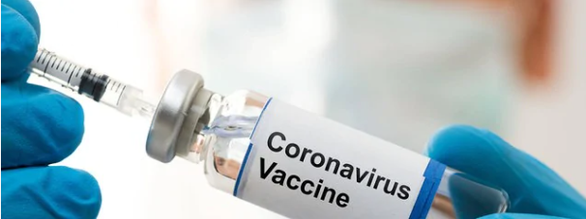
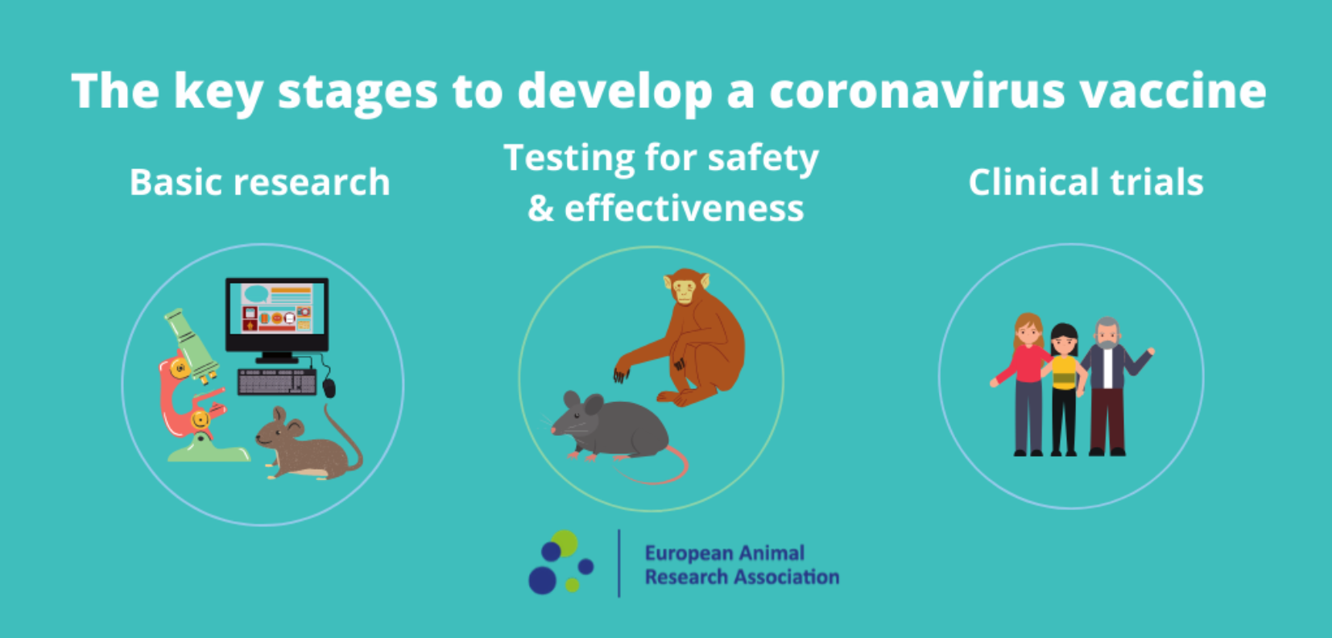
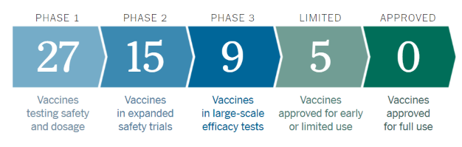
Subject in Focus Small group of rich nations has bought up more than half the future supply of leading COVID-19 vaccine contenders
Introduction:
Around 250 different vaccine candidates against the SARS-CoV-2 coronavirus are currently in different phases of development worldwide. Among them are almost all
Oxfam analysed the deals that pharmaceutical corporations and vaccine producers have already struck with nations around the world for the five leading vaccine candidates currently in phase 3 clinical trials.
The international agency also warned that the same companies simply do not have the capacity to make enough vaccines for everyone who needs one. Even in the extremely unlikely event that all five vaccines succeed, nearly two thirds (61 percent) of the world’s population will not have a vaccine until at least 2022. It’s far more likely some of these experiments will fail, leaving the number of people without access even higher.
One of the leading vaccine candidates, developed by Moderna, has received $2.48 billion in committed taxpayer’s money. Despite this, the company has said it intends to make a profit from its vaccine and has sold the options for all of its supply to rich nations. While it may be making real efforts to scale up supply, according to reports, the company only has the capacity in place to produce enough for 475 million people, or 6 percent of the world’s population.
Oxfam and other organizations across the world are calling for a People’s Vaccine ―available to everyone, free of charge and distributed fairly based on need. This will only be possible if pharmaceutical corporations allow vaccines to be produced as widely as possible by freely sharing their knowledge free of patents, instead of protecting their monopolies and selling to the highest bidder.
Beyond the five leading vaccine candidates, reported vaccine deals also reveal stark inequalities between countries. The UK government has managed to secure deals on several leading vaccine candidates, equivalent to five doses per head of population. By contrast, Oxfam analysis reveals that Bangladesh has so far secured only one dose for every nine people.
There are also large differences in the willingness of pharmaceutical companies to set aside supply for poorer nations.
While Moderna has so far pledged doses of its vaccine exclusively to rich countries, AstraZeneca has pledged two-thirds (66 percent) of doses to developing countries. Although AstraZeneca has done most to expand its production capacity by partnering with and transferring its technology to other manufacturers, it could still only supply up to 38 percent of the global population, and only half of this if its vaccine requires two doses.
The estimated cost of providing a vaccine for everyone on Earth is less than 1 percent of the projected cost of COVID-19 to the global economy. The economic case for requiring pharmaceutical companies to share their vaccine knowledge free of patents so that production can be scaled up as fast as possible could not be clearer, the agency said.
Source: https://www.oxfam.org/en/press-releases/small-group-rich-nations-have-bought-more-half-future-supply-leading-covid-19
conceivable vaccination strategies, from classic inactivated vaccines that contain the killed virus, to vaccines with carrier viruses, to new types of genetic engineering vaccines, which are supposed to inject the instructions for parts of viral proteins into the cells.
Source: https://www.wissenschaft.de/gesundheit-medizin/corona-impfstoffe-hoffnungsvolle-ergebnisse-bei-zwei-kandidaten/
The development cycle of a vaccine, from lab to clinic.
PRECLINICAL TESTING: Test a new vaccine on cells and then give it to animals to see if it produces an immune response.
PHASE 1 SAFETY TRIALS: The vaccine is admitted to a small number of people to test safety and dosage as well as to confirm that it stimulates the immune system.
PHASE 2 EXPANDED TRIALS: Scientists give the vaccine to hundreds of people split into groups, such as children and the elderly, to see if the vaccine acts differently in them. These trials further test the vaccine’s safety and ability to stimulate the immune system.
PHASE 3 EFFICACY TRIALS (currently 5 candidates): The vaccine is given to thousands. These trials can determine if the vaccine protects against the coronavirus. It is required to immunity for at least 50% of vaccinated people to be considered vaccine effective. Phase 3 trials are large enough to reveal evidence of relatively rare side effects that might be missed in earlier studies.
EARLY OR LIMITED APPROVAL: China and Russia have approved vaccines without waiting for the results of Phase 3 trials. It is sad that the rushed process has serious safety risks.
APPROVAL: Regulators in each country review the trial results and decide whether to approve the vaccine or not. During a pandemic, a vaccine may receive emergency use authorization before getting formal approval. Once a vaccine is licensed, researchers continue to monitor people who receive it to make sure it’s safe and effective.
Source: https://www.nytimes.com/interactive/2020/science/coronavirus-vaccine-tracker.html?campaign_id=154&emc=edit_cb_20200922&instance_id=22428&nl=coronavirus-briefing&regi_id=133654920&segment_id=38746&te=1&user_id=363383ed99046d5f1c75f18e67981a29
Main Topic: Wealthy nations representing just 13 percent of the world’s population have already cornered more than half (51 percent) of the promised doses of leading COVID-19 vaccine candidates, Oxfam warned today as the health and finance ministers of G20 countries meet to discuss the global pandemic.

Slide 5
In the press
This section aims at summarizing trending headlines with regards to COVID-19. The collection does not aim at being comprehensive and we would like to point out that headlines and linked articles are no scientific material and for information purposes only. The headlines and linked articles do not reflect NATO’s or NATO MilMed COE FHPB’s view. Feedback is welcome!
23rd September 2020
DW
Coronavirus: Uptick in cases after Pakistan reopened schools
https://www.dw.com/en/coronavirus-uptick-in-cases-after-pakistan-reopened-schools/av-55023728
23rd September 2020
South China Morning Post
Coronavirus: pets may be more susceptible to Covid-19 than first thought, study says
https://www.scmp.com/news/china/science/article/3102711/coronavirus-pets-may-be-more-susceptible-covid-19-first-thought
24th September 2020
The Guardian
'Close to 100% accuracy': Helsinki airport uses sniffer dogs to detect Covid
https://www.theguardian.com/world/2020/sep/24/close-to-100-accuracy-airport-enlists-sniffer-dogs-to-test-for-covid-19
21st September 2020
South China Morning Post
Coronavirus: second wave over winter ‘inevitable’ in China, infectious disease expert says
https://www.scmp.com/news/china/science/article/3102415/coronavirus-second-wave-over-winter-inevitable-china-infectious
24th September 2020
Aljazeera
UK to host ‘human challenge’ trials for COVID-19 vaccines
https://www.aljazeera.com/news/2020/9/24/uk-to-host-human-challenge-trials-for-covid-19-vaccines
23rd September 2020
DW
COVID-19 has led to trillion-dollar losses for workers around world
https://www.dw.com/en/covid-19-has-led-to-trillion-dollar-losses-for-workers-around-world/a-55026876
24th September 2020
South China Morning Post
Coronavirus: Philippines braces to retrain 300,000 citizens returning from working abroad
https://www.scmp.com/news/asia/southeast-asia/article/3102847/philippines-braces-retrain-300000-citizens-returning
21st September 2020
Aljazeera
Myanmar locks down Yangon region after record jump in COVID cases
https://www.aljazeera.com/news/2020/9/21/myanmar-locks-down-yangon-region-after-record-jump-in-covid-cases

Slide 6
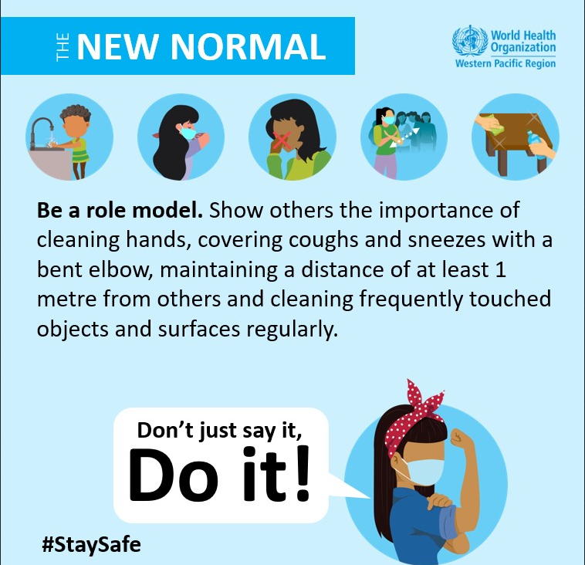
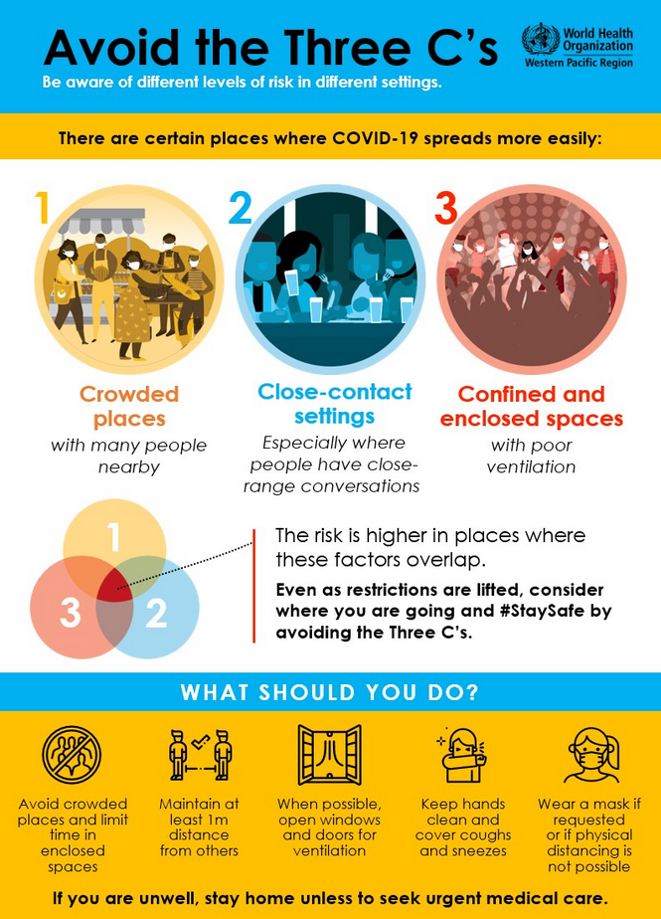
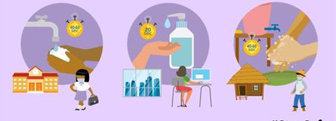
The new normal!
In some places, as cases of COVID-19 go down, some control measures are being lifted.
But this doesn’t mean we should go back to the ‘old normal’. If we don’t stay vigilant and protect ourselves and others, coronavirus cases may go up again.​
If we stop following the key protective measures, coronavirus can come rushing back.​
Now, more than ever, it’s important that we all follow our national health authority’s advice and be part of helping to prevent coronavirus transmission.
Wherever you are, you still need to protect yourself against COVID-19.
Even as restrictions are lifted, consider where you are going and stay safe.​

Slide 7
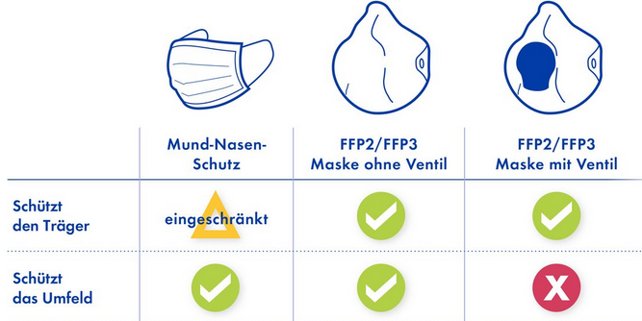
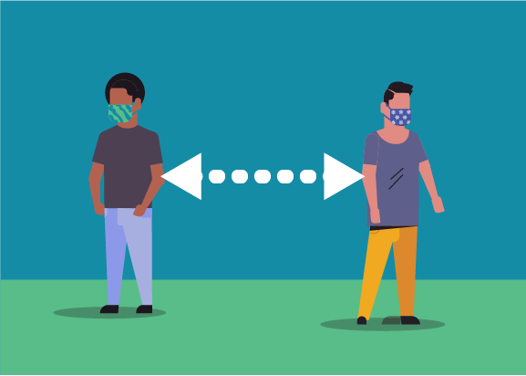
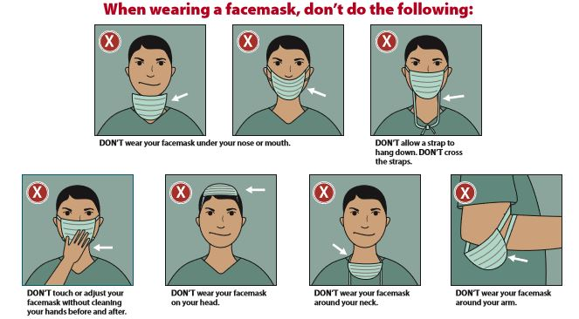
The perfect wave – why masks are still important
NEW STUDY ON MOUTH NOSE PROTECTION AND SOCIAL DISTANCING
Unfortunately, in the epicenter of the new hot spots areas often enough people are seen who do not adhere to the still valid protective regulations such as social distancing and the correct wearing of a nose and mouth protection. It could be as simple as that - new studies show that these two measures make a significant contribution to reducing the probability of transmission.
In the case of protective masks with an advertised protective effect in connection with SARS-CoV-2, depending on the intended purpose, a distinction is made between two types:
Medical face masks (MNS; surgical (surgical) masks); are primarily used for third-party protection and protect the person against the exposure of potentially infectious droplets of the person wearing the face mask. Corresponding MNS protect the wearer of the mask if the fit is tight, but this is not the primary purpose of MNS. This is e.g. used to prevent droplets from the patient's breathing air from getting into open wounds of a patient. Since, depending on the fit of the medical face mask, the wearer not only breathes in through the filter fleece, but the breathing air is drawn in as a leakage current past the edges of the MNS, medical face masks generally offer the wearer little protection against aerosols containing excitation. However, you can protect the mouth and nose area of ​​the wearer from the direct impact of exhaled droplets from the other person as well as from pathogen transmission through direct contact with the hands.
Particle-filtering half masks (FFP masks); are objects of personal protective equipment (PPE) in the context of occupational safety and are intended to protect the wearer of the mask from particles, droplets and aerosols. The design of the particle-filtering half masks is different. There are masks without an exhalation valve and masks with an exhalation valve. Masks without a valve filter both the inhaled air and the exhaled air and therefore offer both internal and external protection, although they are primarily designed for internal protection only. Masks with valves only filter the inhaled air and therefore offer no external protection!!!
As a large number of unrecognized people move around in public spaces without symptoms, mouth and nose protection protects other people, thereby reducing the spread of the infection and thus indirectly reducing the risk of becoming infected
Mouth and nose protection
FFP2/FFP3
mask without valve
FFP2/FFP3
mask with valve
Protects wearer of mask
limited
Protects periphery
Due to the occasion, it should be pointed out again and again, also by executives, that the correct way of wearing the mask is essential to achieve maximum protection. The mask wrong, e.g. for example, wearing it under the nose means accepting a possible infection of others. FFP2 / 3 masks are still considered deficient equipment and should be kept available for healthcare workers and emergency services.
https://www.sueddeutsche.de/gesundheit/atemschutzmaske-coronavirus-maske-schutz-1.4867144
https://www.cdc.gov/coronavirus/2019-ncov/prevent-getting-sick/diy-cloth-face-coverings.html
https://www.bfarm.de/SharedDocs/Risikoinformationen/Medizinprodukte/DE/schutzmasken.html

Slide 8
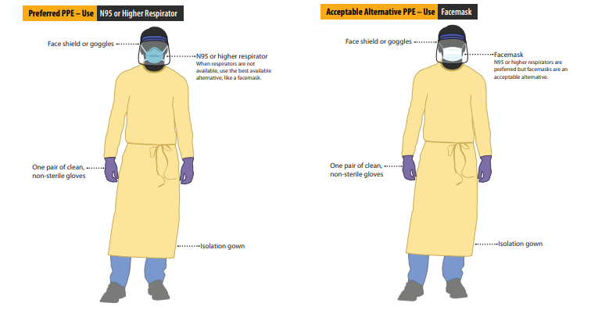
Using Personal Protective Equipment (PPE) when caring for Patients with confirmed or suspected COVID-19
Who needs PPE:
Patients with confirmed or possible SARS-CoV-2 infection should wear a facemask when being evaluated medically
Healthcare personnel should adhere to Standard and Transmission-bases Precautions when caring for patients with SARS-CoV-2 infection. Recommended PPE is describe in the Infection Control Guidance.
Before caring for patients with confirmed or suspected COVID-19, healthcare personnel (HCP) must:
Receive comprehensive training on when and what PPE is necessary, how to don (put on) and doff (take off) PPE, limitations of PPE, and proper care, maintenance, and disposal of PPE
Demonstrate competency in performing appropriate infection control practices and procedures
Remember:
PPE must be donned correctly before entering the patient area
PPE must remain in place and be worn correctly for the duration of work in potentially contaminated areas
PPE should not be adjusted during patient care and
PPE must be removed slowly and deliberately in a sequence that prevents self-contamination
Donning (putting on the gear):
Identify and gather the proper PPE to don. Ensure choice of gown size is correct.
Perform hand hygiene using hand sanitizer
Put on isolation gown. Assistance may be needed by other HCP
Put on NIOSH-approved N95 filtering facepiece respirator of higher (use a facemask if a respirator is not available.
Respirator straps should be placed on crown of head and base of neck. Perform a user seal check each time you put on the respirator.
Facemask should be secured on crown of head and base of nex. If mask has loops, hook them appropriately around your ears.
5. Put on face shield or googles.
6. Put on gloves
7. HCP may now enter patient room
Doffing (taking off the gear):
Remove gloves. Ensure gloves removal does not cause additional contamination of hands.
Remove gown. Untie all tis. Some gown ties can be broken rather than untied. Do so in gentle manner, avoiding a forceful movement. Reach up to the shoulders and carefully pull gown down and away from the body.
HCP may now exit patient room.
Perform hand hygiene.
Remove face shield or googles. Carefully remove face shield or googles by grapping the strap and pulling upwards and away from head. Do not touch the front of face shield or googles.
Remove and discard respirator. Remove the bottom strap by touching only the strap and bring it carefully over the head. Grasp the top strap and bring it carefully over the head and then pull the respirator away from the face without touching the front of the respirator or facemask.
Perform hand hygiene after removing the respirator/facemask
Source: https://www.cdc.gov/coronavirus/2019-ncov/hcp/using-ppe.html

